Slide 1
Gartner’s 3S

Slide 2
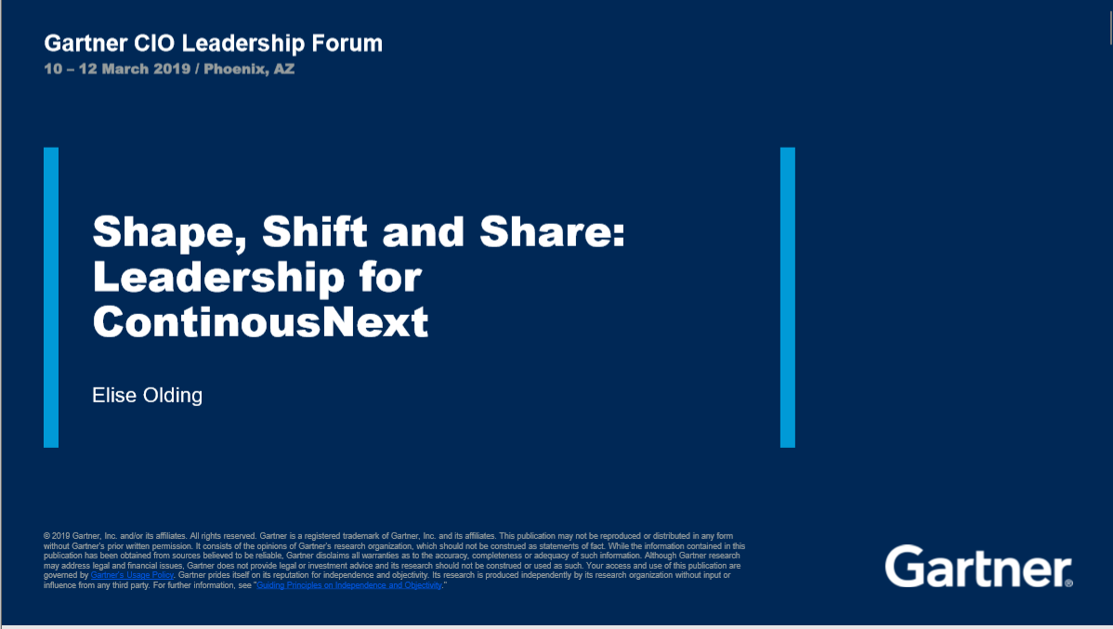

Slide 3
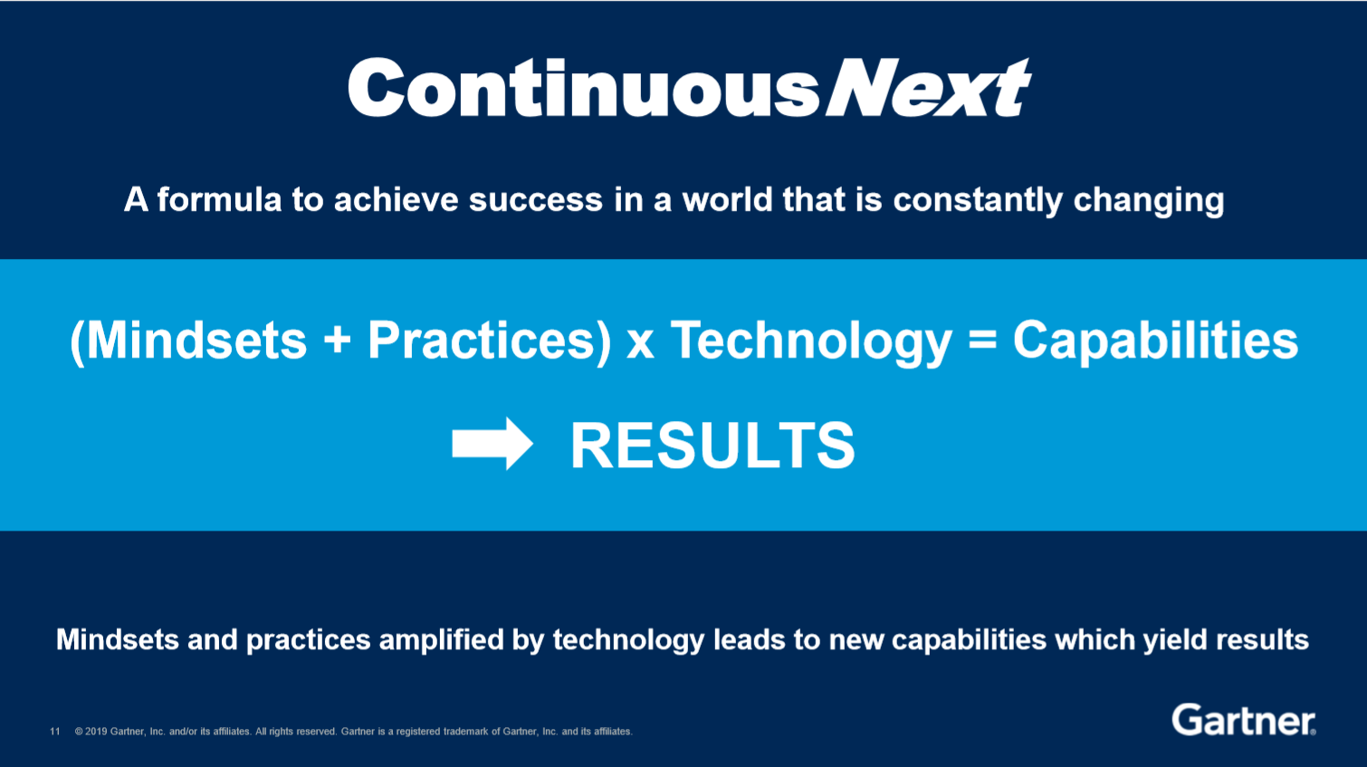
ContinuousNext
the posture everyone should adopt in order to face and adapt to changes in technology, competition, and business

Slide 4

定性心態(Fixed Mindset) vs. 成長心態(Growth Mindset)
"In [the growth] mindset, the hand you're dealt is just the starting point for development," explains Dweck in Mindset. "Everyone can change and grow through application and experience.“
對屬於成長心態的人來說，你拿到的牌只是你開始成長的起點，每個人都可以經由嘗試與經歷，獲得改變與成長。
-- Satya Nadella, CEO of Microsoft

Slide 5
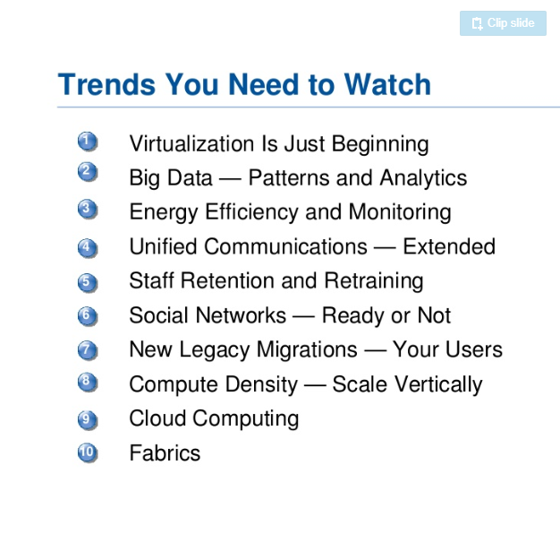
Technology
Top 10 Trends To Watch in IT Infra and Operations by Gartner

Slide 6
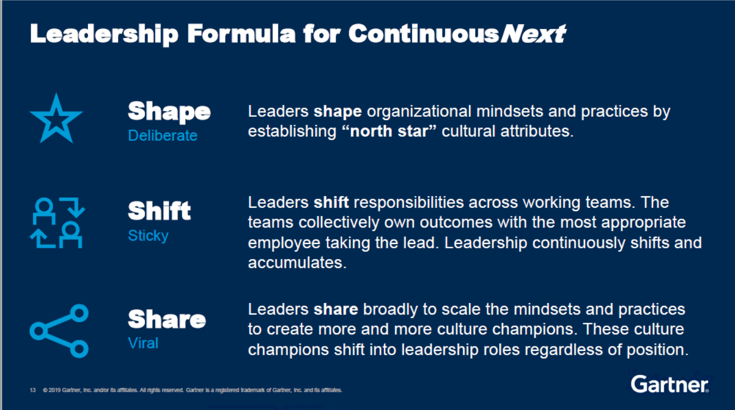
Leadership Formula for Continuous Next

Slide 7
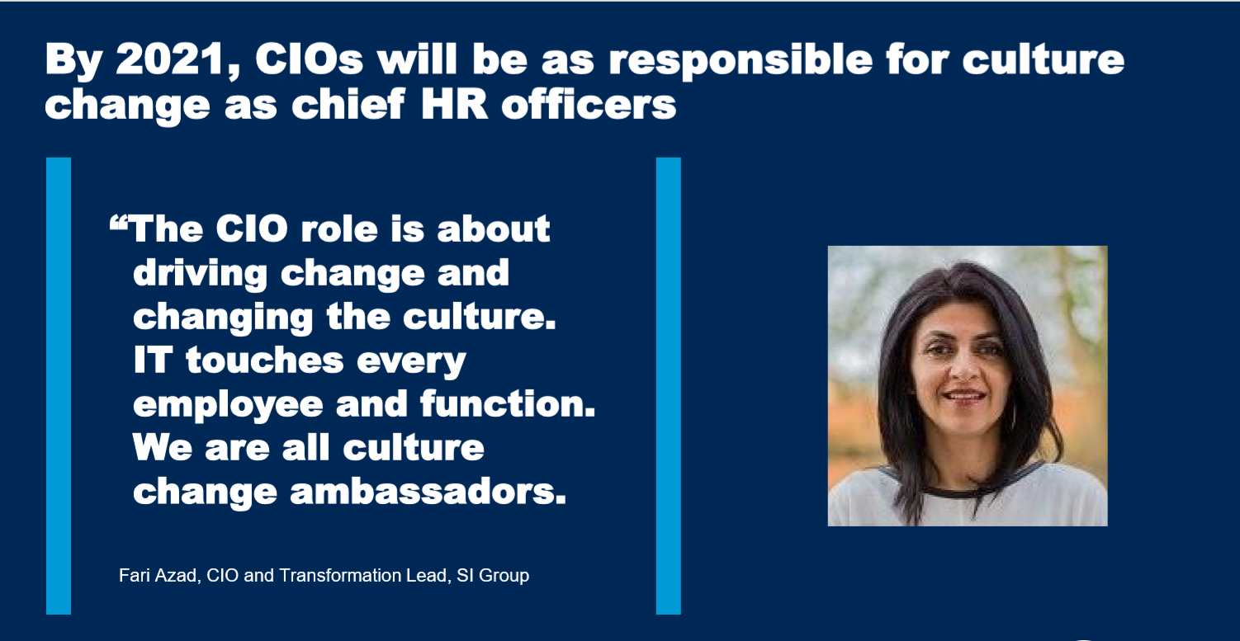
Shape

Slide 8
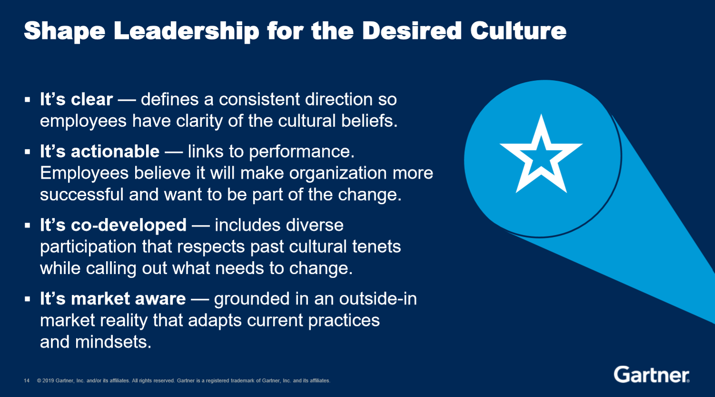
Shape

Slide 9


瑪琳•奇兹姆 Marlene Chism 諮詢顧問 國際演說家
著作：
《 No-Drama Leadership》
《 Stop Workplace Drama》
《 7 Ways to Stop Workplace Drama in Your Healthcare Practice》

Slide 10
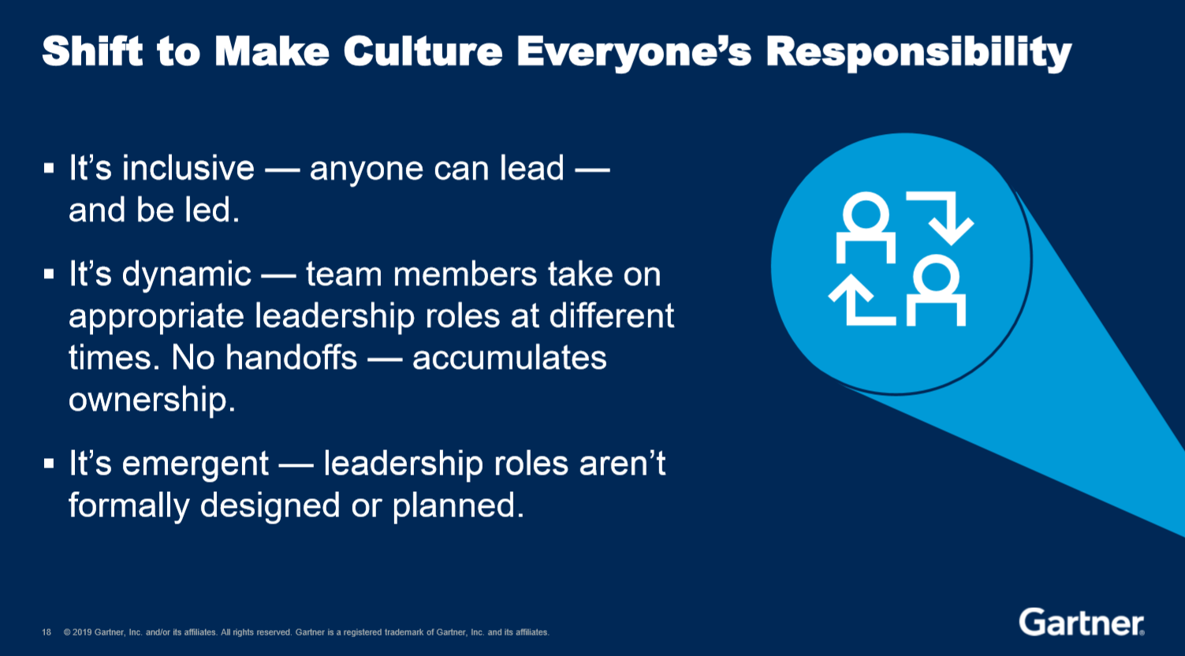
Shift

Slide 11

Delegation
As Covey defines it, “delegating involves clear, up-front mutual understanding and commitment in five areas.” Here are the five:
Desired results:
Guidelines:
Resources:
Accountability:
Consequences:

Slide 12
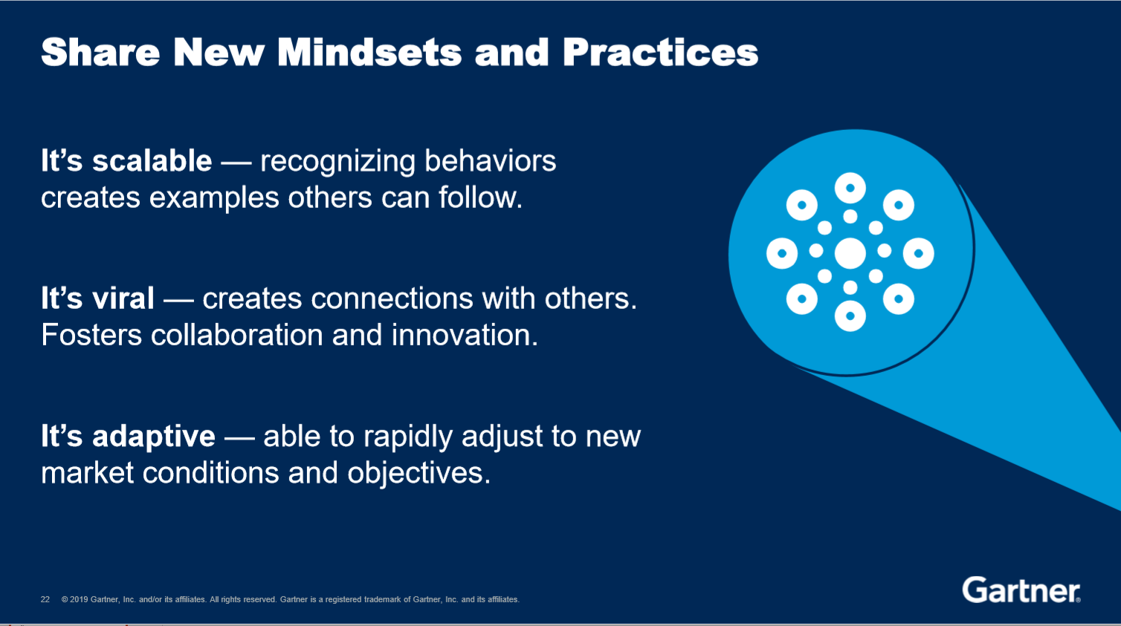
Share

Slide 13
Share
找資料中

